Slide 1
Provo Canyon: Substation Cut (2005)
Rebecca Black, Michael Freeman, Lizzy Roper

Slide 2
Background
In 2005 a project was underway to widen a 5.2-mile stretch of US-189 from two to four lanes; a two mile portion of the roadway needed to be completely realigned.
Provo River on one side of the highway, and steep slopes on the other side.
A major prehistoric landslide occurred in a nearby area called the Hoover Slide.
The underlying material consisted of Manning Canyon Shale, which has a low friction angle and negligible cohesion.

Slide 3
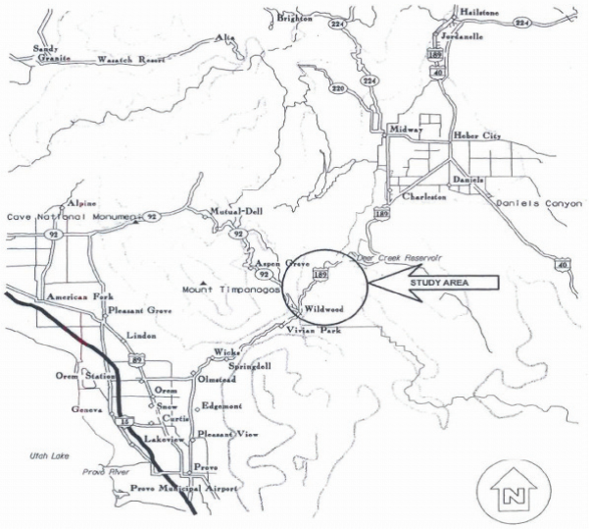
Location

Slide 4
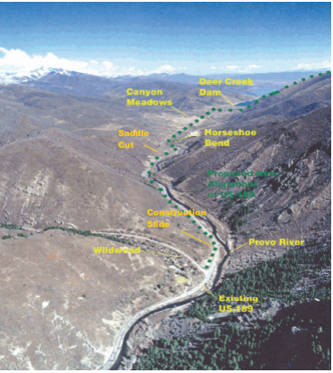
Current and Proposed Alignments

Slide 5
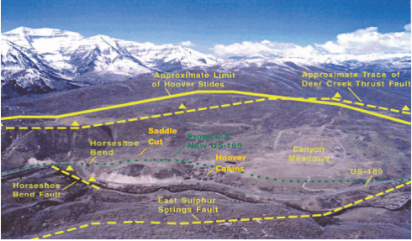
Limits of the Hoover Slide Area (Looking West)

Slide 6
Substation Cut Proposed Design
15 foot soils nails at 8 foot triangular spacing to stabilize the slope
Slope stability was conducted to determine the requirements for a Factor of Safety greater than 1.25.

Slide 7
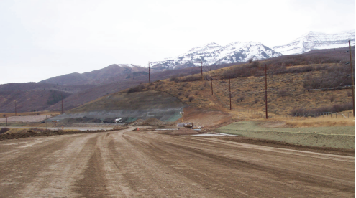
Substation Cut (Looking Southwest)

Slide 8
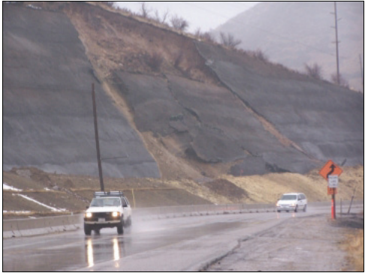
Substation Cut Failure
December 24, 2005

Slide 9
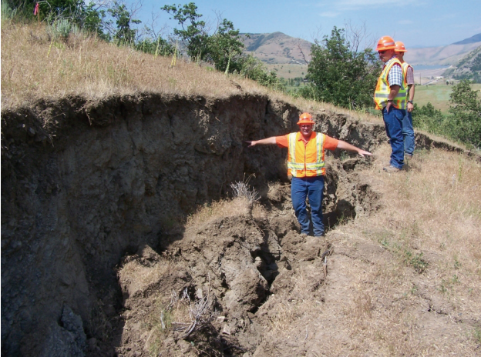
Head Scarp at Saddle Cut

Slide 10
Analysis Information
Cut slope 1:1.33 H:V
Maximum height of 100 ft
40 ft silt with gravel and cobbles over dense sandy gravel and cobbles; underneath these layers is the Manning Canyon shale zone.
Cohesion assumed negligible for all layers
Unit weight of 130 pcf for top two layers, 120 pcf for shale layer

Slide 11
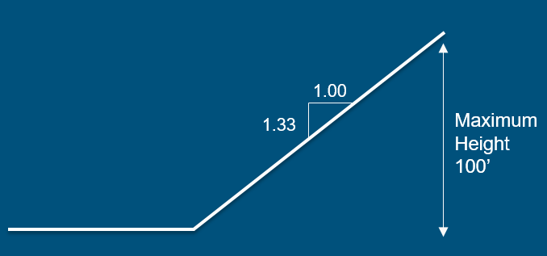
Analysis

Slide 12
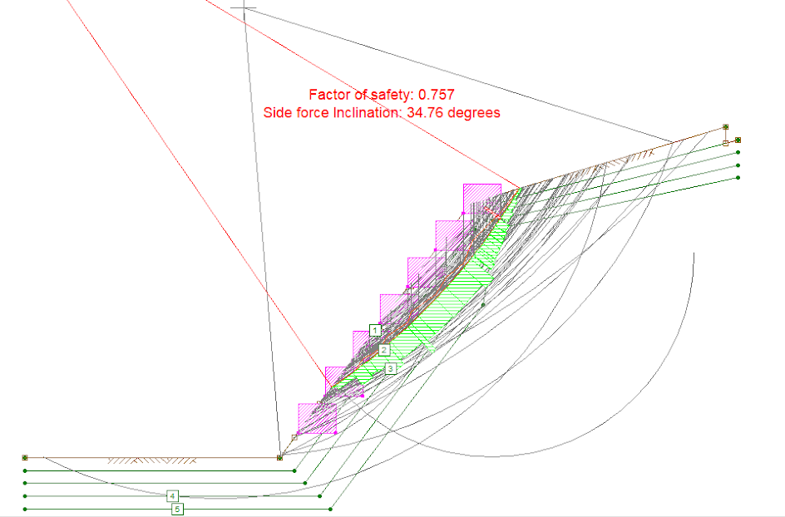
UTEXAS Analysis

Slide 13
Conclusion
To prevent future slides, a berm was placed in front of the slope failure and through the Manning Canyon Shale zone that was found.
To provide a lasting fix, the upper portion of the slope was laid back to relieve loading.
Temporary soil nails were used during the removal of the failure zone.
Much was learned about construction in zones of Manning Canyon Shale and about soil types in Provo Canyon area.

Slide 14
Questions?

